Slide 1
Grade Archive System for Public Schools
Adriano, Patrick Cedie Apit, Mark Justine Fonacier, Tyrone Edward

Slide 2
INTRODUCTION

Slide 3
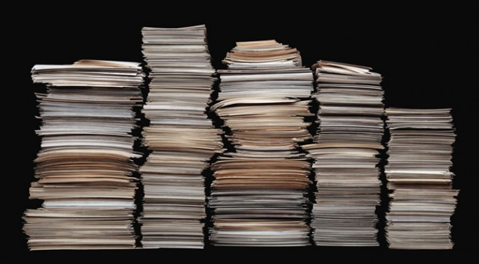

PROJECT CONTEXT

Slide 4
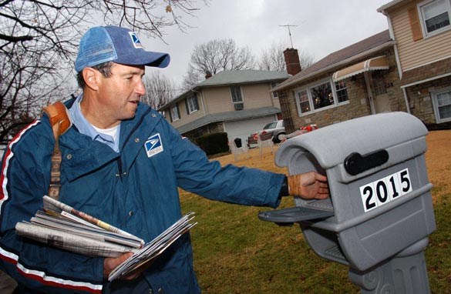

PROJECT CONTEXT

Slide 5


PROJECT CONTEXT

Slide 6
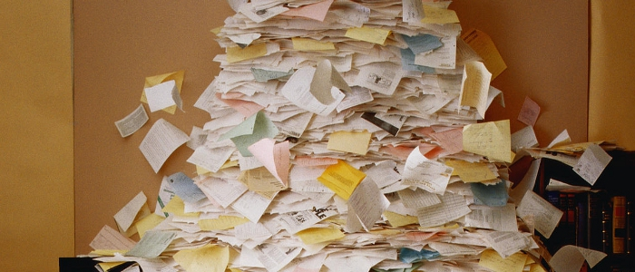
PROJECT CONTEXT

Slide 7
Statement of the Problem
Prone to Damage
Usage of ECR is Difficult
Inefficient Storage
Time Consuming
Teacher Unavailability

Slide 8

PURPOSE AND DESCRIPTION
Provide Bangkal Main Elementary School:
A centralized grade archive system
Safe and secured data
Paperless recording
Cloud Computing using Amazon Web Service(AWS)

Slide 9

OBJECTIVES
Digitize all records
Secure the records
Remove the manual transferring of files

Slide 10

OBJECTIVES
Digitize all records
Secure the records
Remove the manual transferring of files

Slide 11

OBJECTIVES
Digitize all records
Secure the records
Remove the manual transferring of files

Slide 12
SCOPE AND LIMITATIONS
Bangkal Main Elementary School
Kindergarten to Grade 6
Accessible only when connected to the internet

Slide 13
RELATED LITERATURE

Slide 14
Document Management System (DMS)
Convenient retrieval
Centralization of archiving
Easier decision making process
Better distribution of work
Better electronic documents handling

Slide 15
Document Management System (DMS)
Not timing consuming
Less space for archiving
Reduces labor
Easy access to files
Eliminates lost and misplaced files.

Slide 16

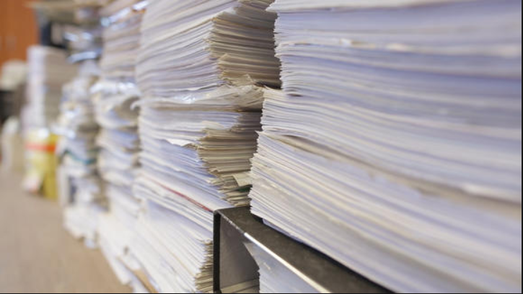
Using Spreadsheets to Keep Track of Students' Grades

Slide 17

Learner Information System (LIS)
Provide a standardized registration
Track learner progress / performance
Provide learner information
Enhance management of learner records.

Slide 18

Electronic Class Record (ECR)
Convenient
Ensures accuracy
Accessible
Sustainable

Slide 19
TECHNICAL BACKGROUND

Slide 20
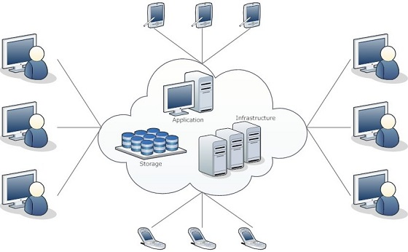
Cloud Computing
Technical Background

Slide 21
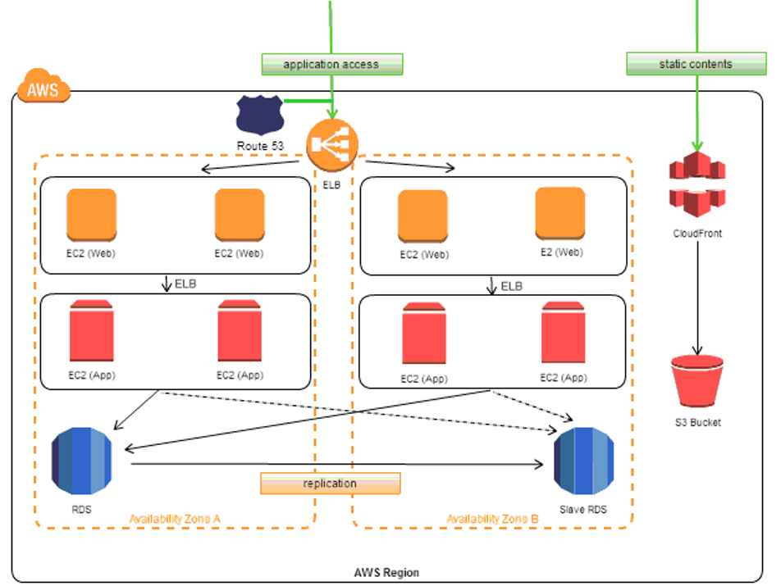
Web App on AWS Virtual Private Cloud
Technical Background

Slide 22
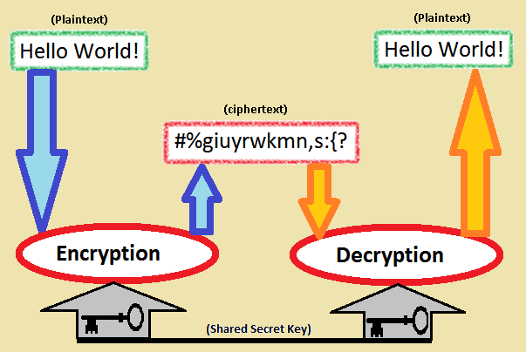
Symmetric Database Encryption
Technical Background

Slide 23
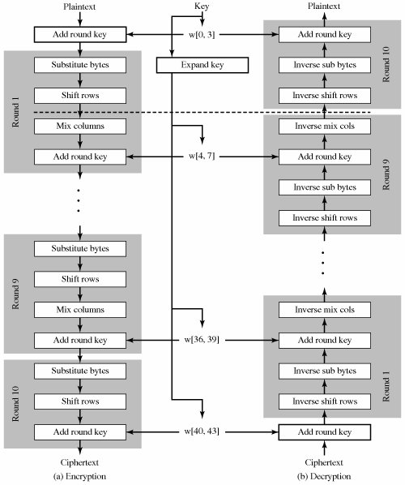
AES Algorithm
Technical Background

Slide 24
DESIGN AND METHODOLOGY

Slide 25
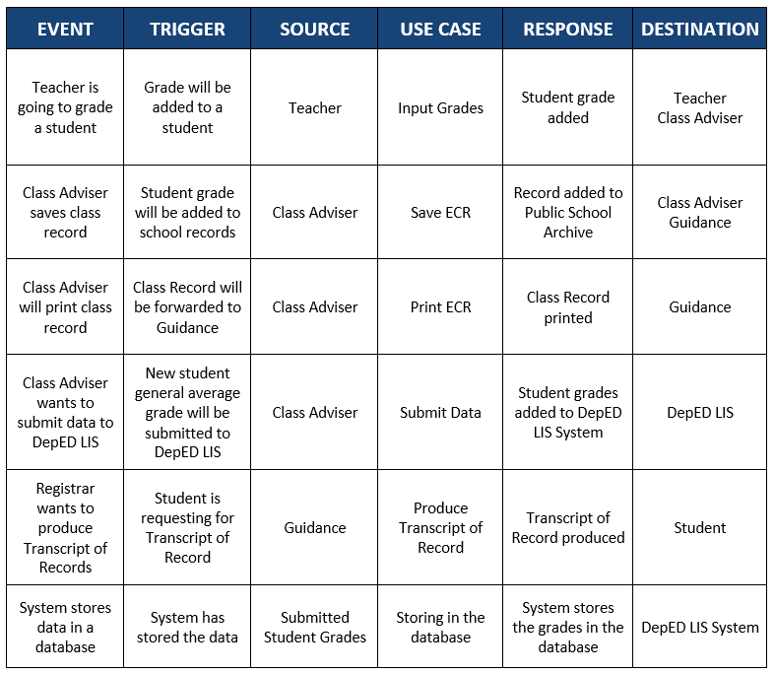
Events Table
Requirements Analysis

Slide 26
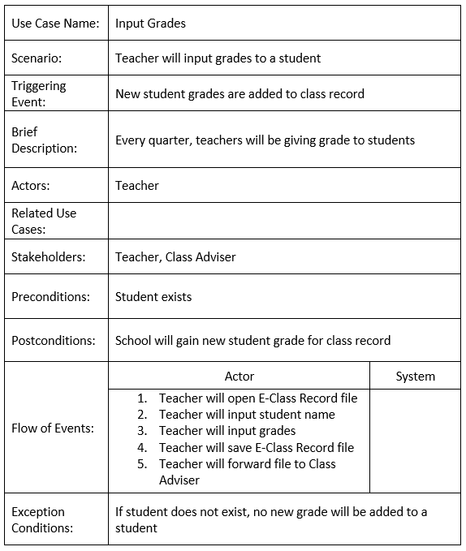
Input Grades
Requirements Documentation

Slide 27
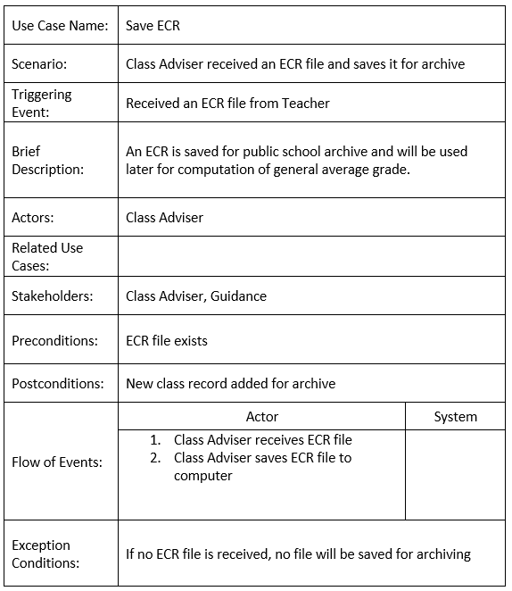
Save ECR
Requirements Documentation

Slide 28
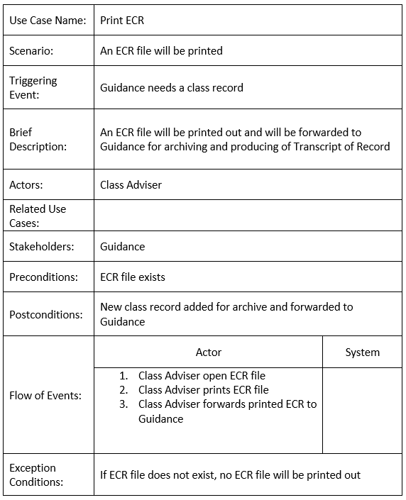
Print ECR
Requirements Documentation

Slide 29
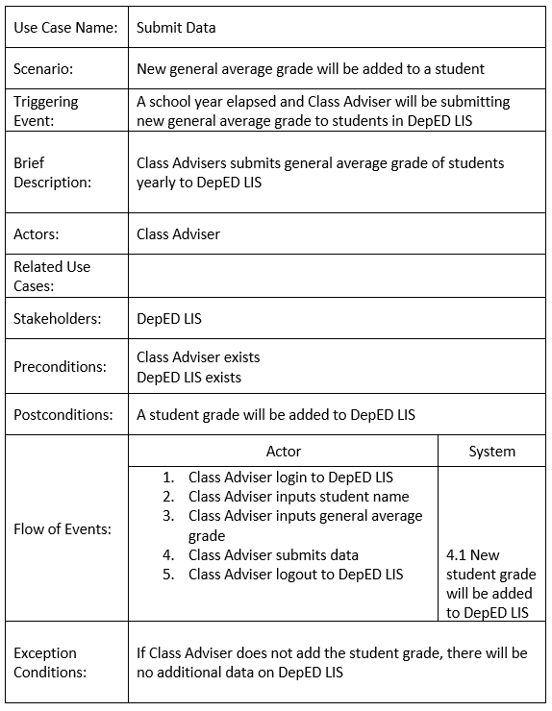
Submit Data
Requirements Documentation

Slide 30
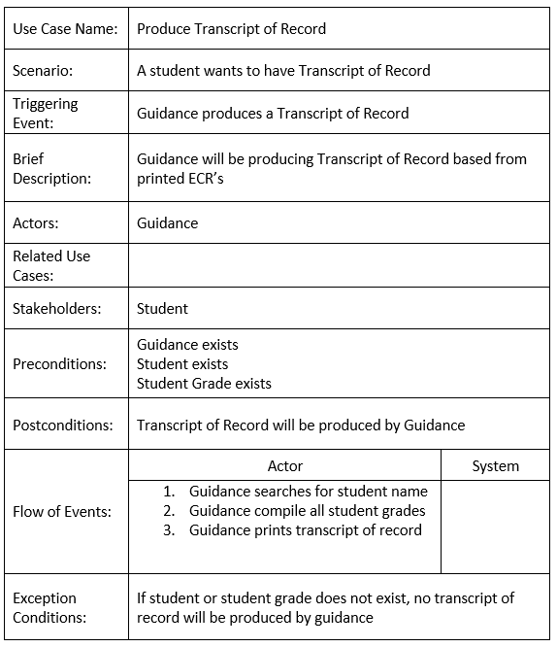
Produce Transcript of Record
Requirements Documentation

Slide 31
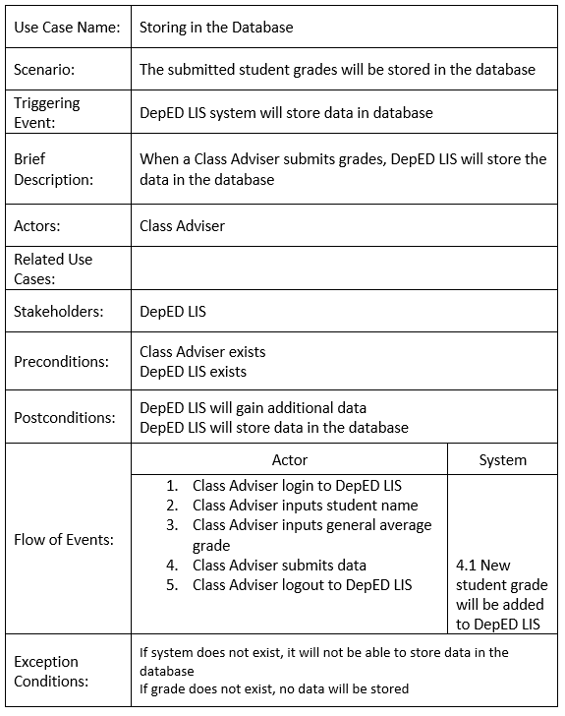
Storing in the Database
Requirements Documentation

Slide 32
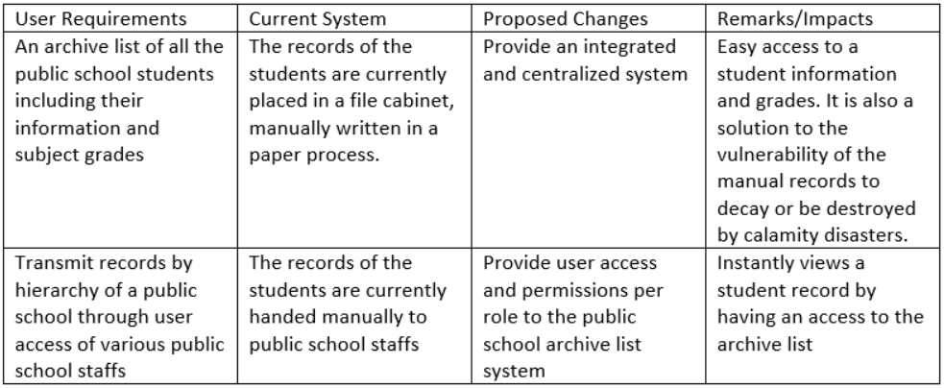
Gap Analysis
Requirements Documentation

Slide 33
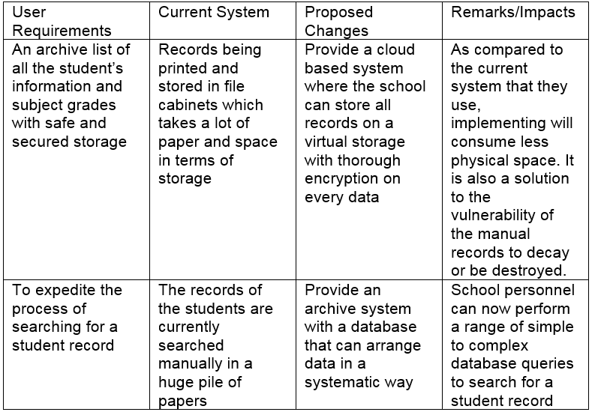
Gap Analysis/Needs Assessment

Slide 34
Design of Software, Systems, Product, and/or Process
Confirm the personnel first
Allow access to add or edit
Encrypt and sent to database

Slide 35
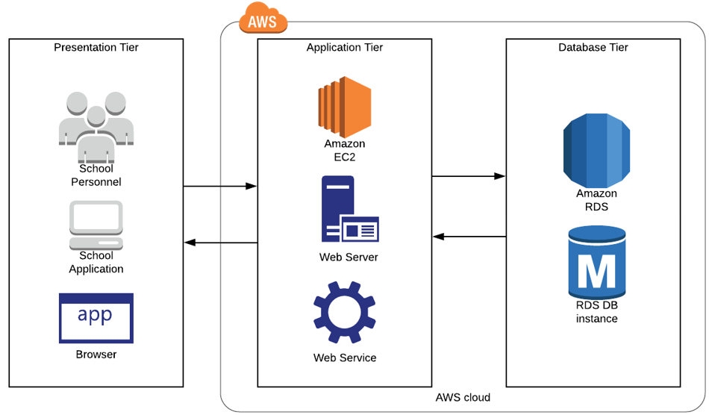
System Architecture

Slide 36
Gap Analysis
Requirements Documentation

Slide 37
UML Diagrams

Slide 38
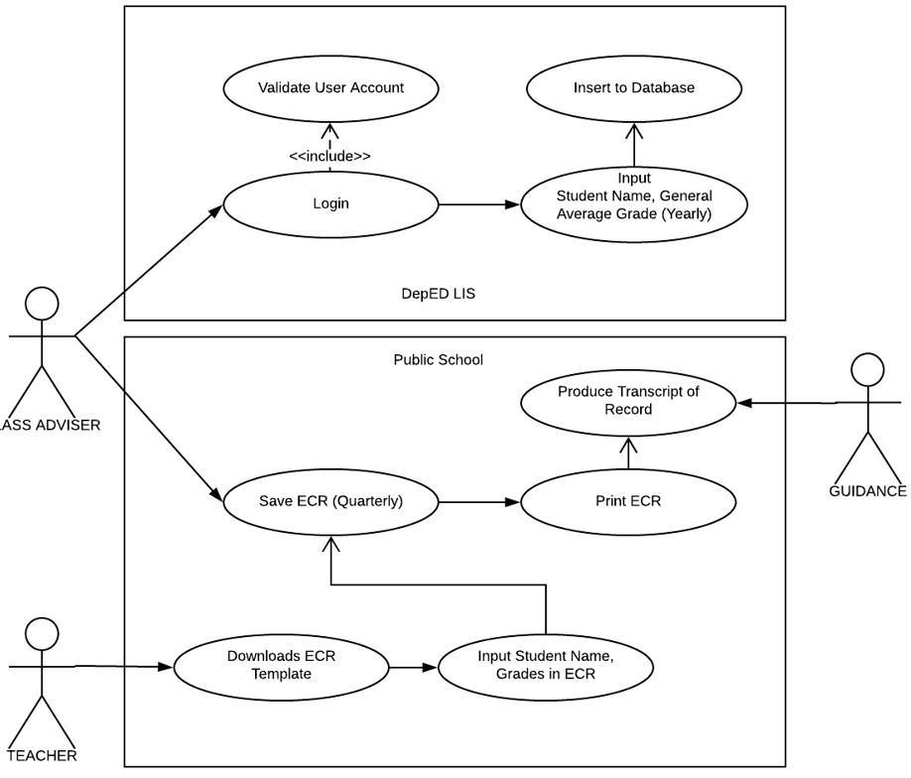
Use Case Diagram

Slide 39
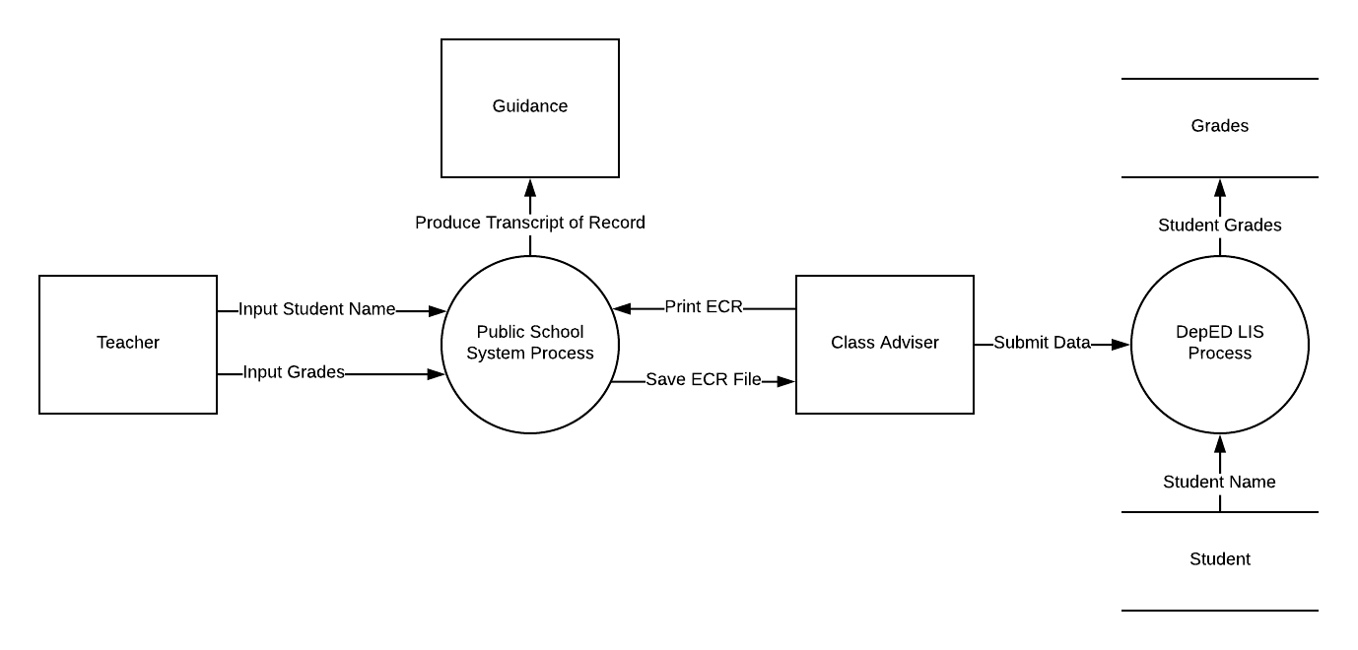
Context Level Diagram

Slide 40
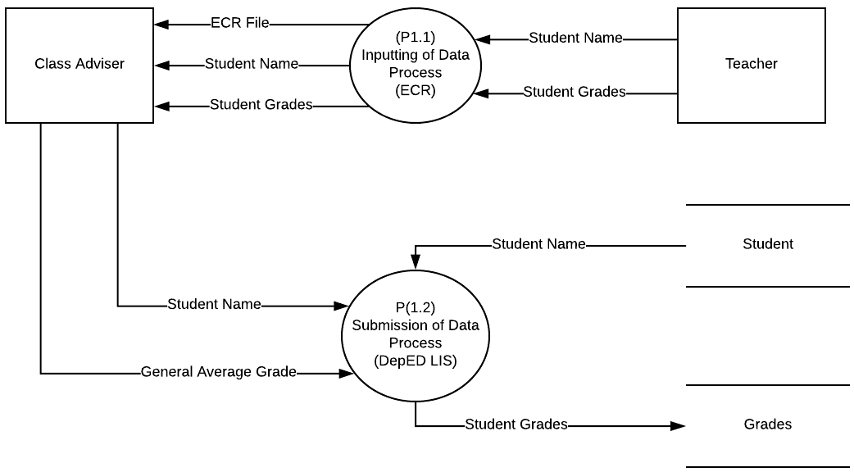
Data Flow Diagram Level 1

Slide 41
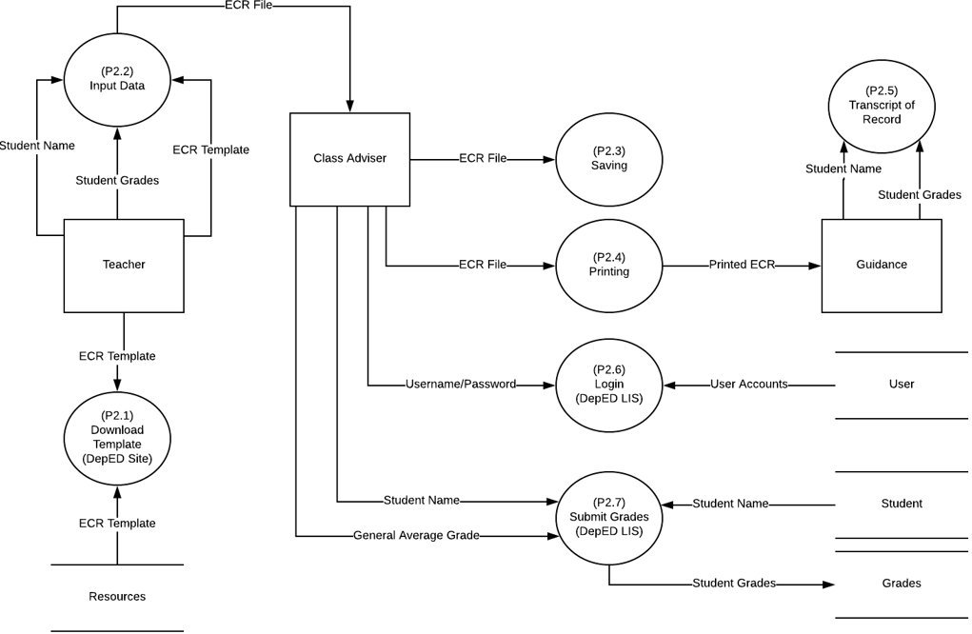
Data Flow Diagram Level 2

Slide 42
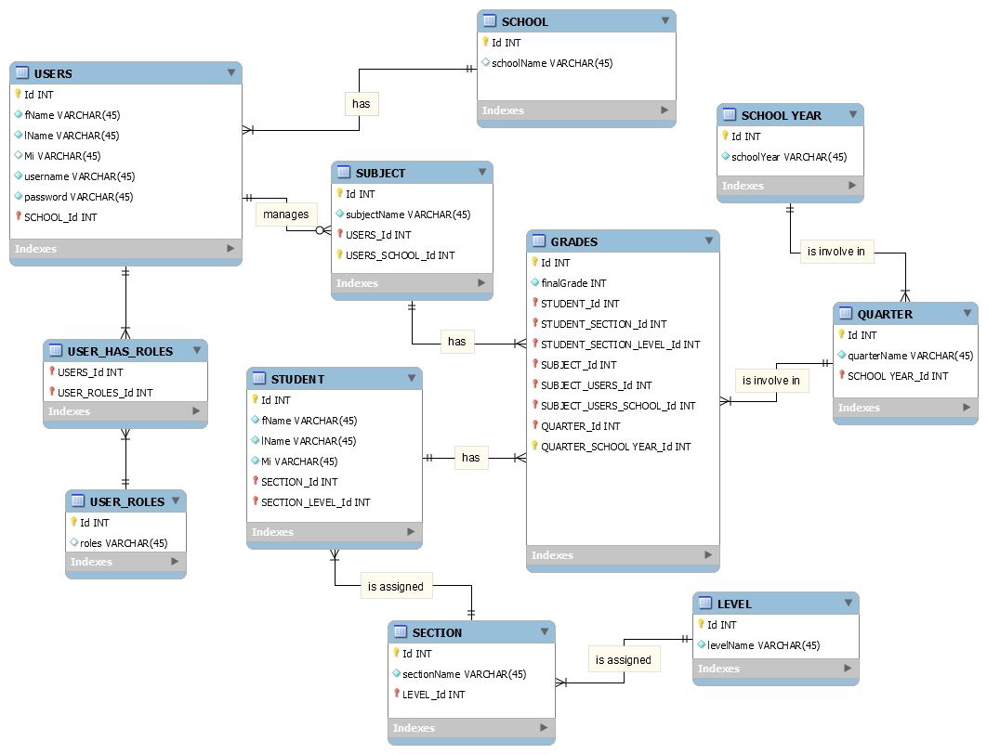
Entity Relationship Diagram

Slide 43
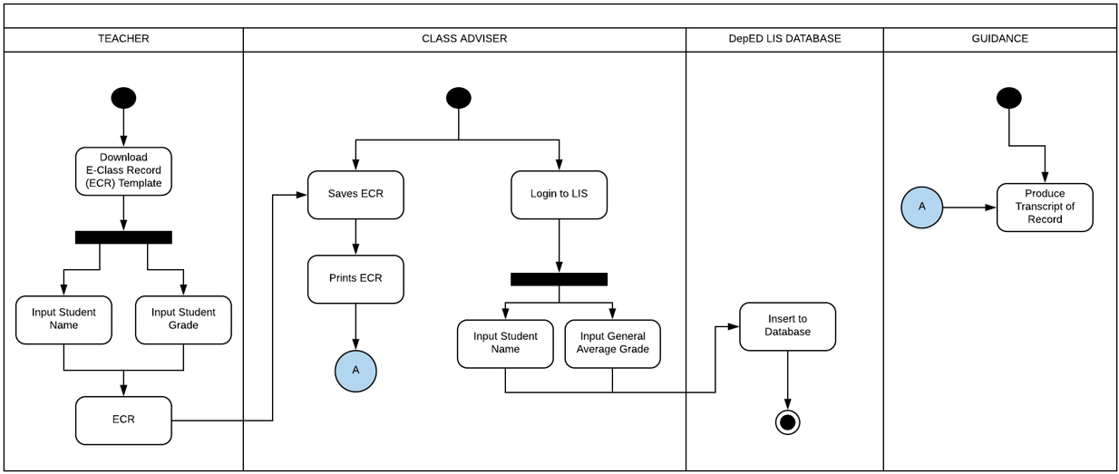
Activity Diagram

Slide 44
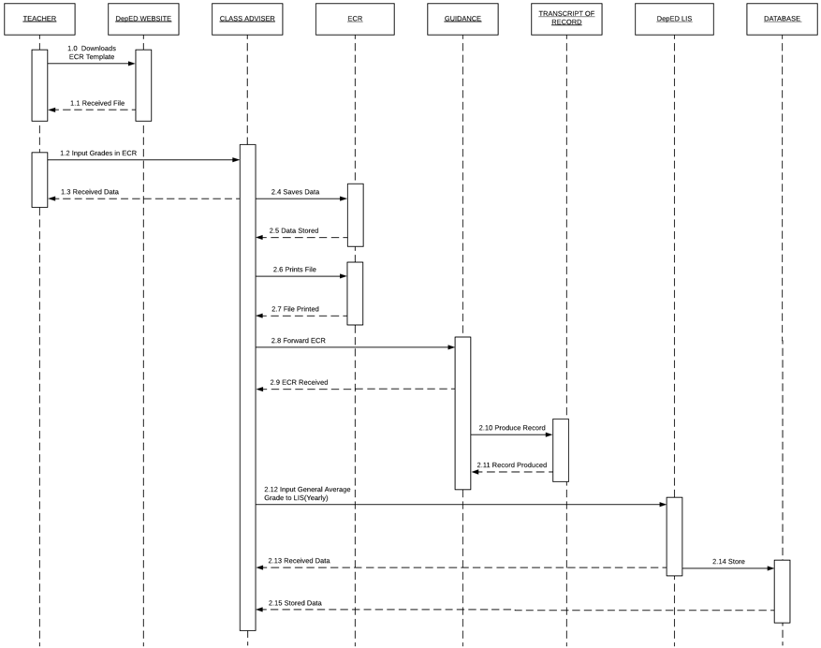
System Sequence Diagram

Slide 45
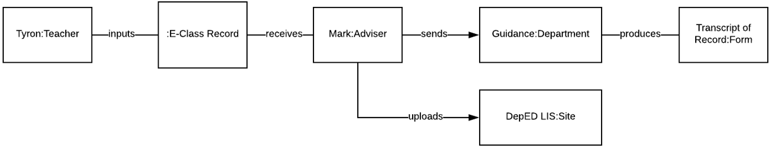
Object Diagram

Slide 46
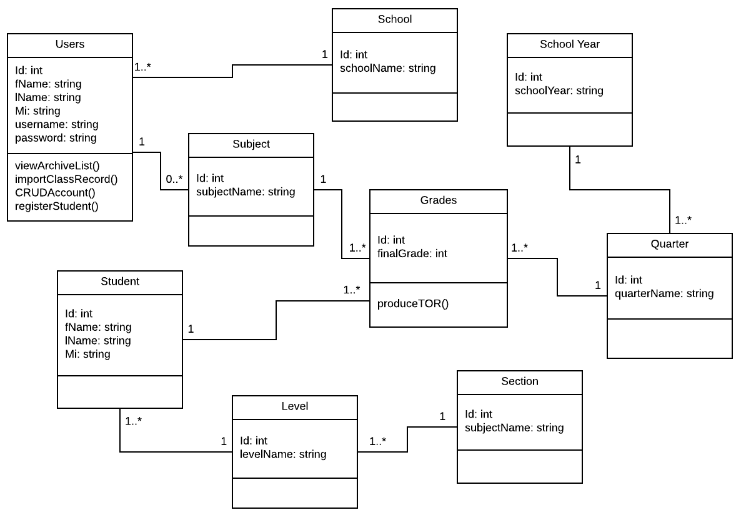
Class Diagram

Slide 47
Appendices

Slide 48
References:
Kelemen, R., & Mekovec, R. (n.d.). Document Management System. A Case Study of Verazdin Country, 1-6. Retrieved from: https://bib.irb.hr/datoteka/345603.Kelemen-Mekovec_-_DMS_-_A_Case_Study_of_Varazdin_Counti_pp41-46s.pdf
Zach, R. (2005). Using Spreadsheets to Keep Track of Students' Grades. Retrieved from: https://www.ucalgary.ca/rzach/teaching/grades.html
Learner Information System (LIS) System Overview. (2017). 1-36. Retrieved from: http://fape.org.ph/addons/tinymce/editor/media/articleimg/2016/DepEd%20Learner%20Information%20System%20(LIS).pdf
Yumi. (2017). Electronic Class Record. Retrieved from: http://guroako.com/2017/04/23/e-classrecordelectronicclassrecord/

Slide 49
Thank you!

